Slide 2
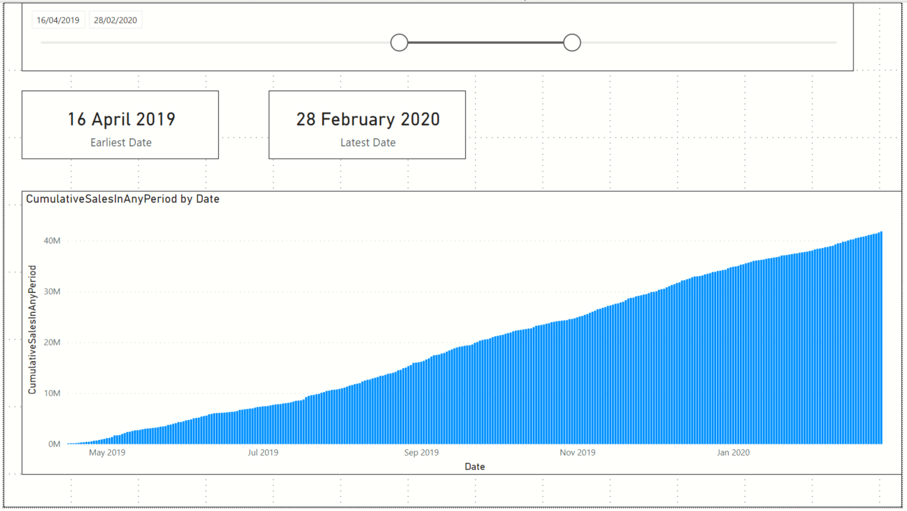
Card showing earliest
MyCalendar[Date]
Slicer on MyCalendar[Date]
Card showing latest
MyCalendar[Date]
Stacked Column Chart visual
X-axis = MyCalendar[Date]
Values = Custom measure CumulativeSalesInAnyPeriod

Slide 3
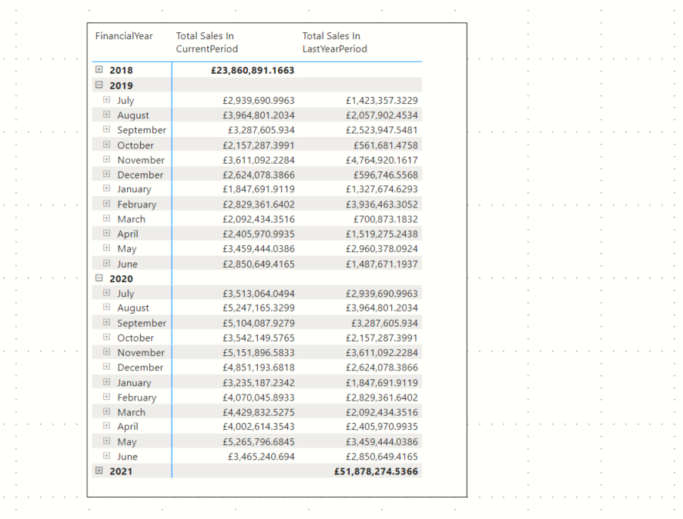
Custom measure TotalSalesInPeriodUsingMyCalendar
Visual hierarchy using the
Financial Year
Financial Month
Day
columns of the MyCalendar[Date]
Custom measure TotalSalesInLastYearPeriodUsingMyCalendar
How do we know this DAX measure works?
The sales for a period in 2020 matches the previous years sales

Slide 4
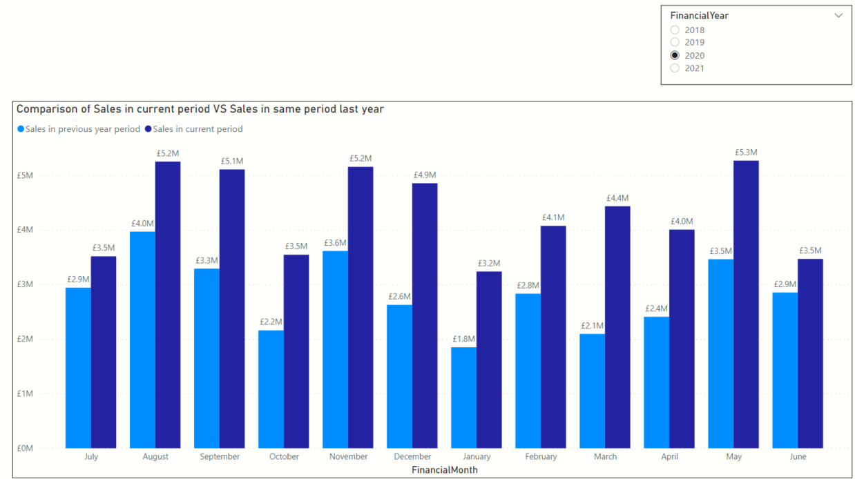
Clustered column chart
X-axis => Financial Month column of MyCalendar
Values => Custom measures
TotalSalesInPeriodUsingMyCalendar
TotalSalesInLastYearPeriodUsingMyCalendar
Slicer
Financial Year column of MyCalendar
Measure TotalSalesInLastYearPeriodUsingMyCalendar
Measure TotalSalesInPeriodUsingMyCalendar

Slide 5
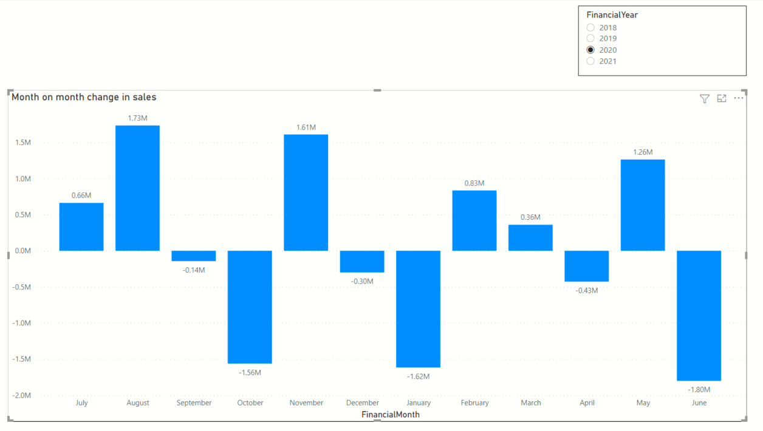
Clustered column chart
X-axis => Financial Month column of MyCalendar
Values => Custom measure MonthOnMonthChangeInSales
Slicer
Financial Year column of MyCalendar
A drop in monthly sales from Dec to January

Slide 6
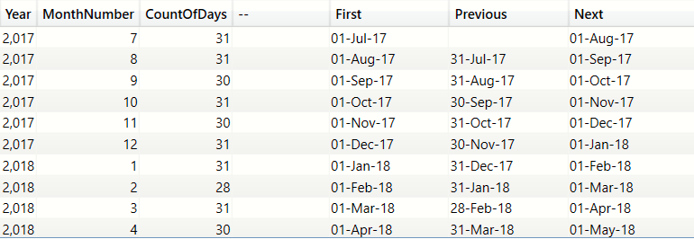
PREVIOUSDAY()
NEXTDAY()
First day in the month
We are in November
First date in current context=Nov 1st
Last date in current context=Nov 30th
PREVIOUSDAY=1 day prior to the first date = 31st Oct
NEXTDAY =1 day after the last date =1st Dec

Slide 7
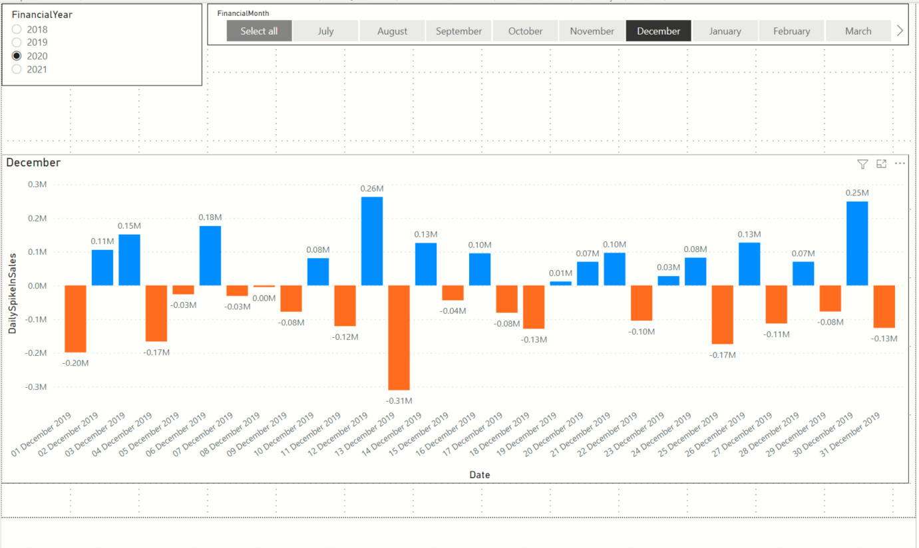
Slicer on MyCalendar[FinancialYear]
Slicer on MyCalendar[FinancialMonth]
Clustered column chart visual
Axis = MyCalendar[Date]
Values = Custom measure ‘DailySpikeInSales’

